Slide 1
Beyond the Front
Militarism and America’s Economy

Slide 2
Agenda
World War II: A Shift to Totality
Korea: The Emergence of the Military-Industrial Complex
The Vietnam Nexus: War at Home and Abroad
The Entrance into the Gulf
The War on Terror and Its Ramifications
Synthesis and Takeaways
Questions, Comments, Answers, and Discussion
Notes:
Introduction and World War II: A Shift to Totality- Ian Proctor
Korea: The Emergence of the Military-Industrial Complex- Nils Kruse
The Vietnam Nexus: War at Home and Abroad- Caroline Larsson
The Entrance into the Gulf- Nicole Longobardo
The War on Terror and Its Ramifications- Maggie Mergen
Synthesis and Takeaways- Ian Proctor
Questions, Comments, Answers, and Discussion- moderated by Andor Skotnes

Slide 3
World War II
A Shift to Totality

Slide 4
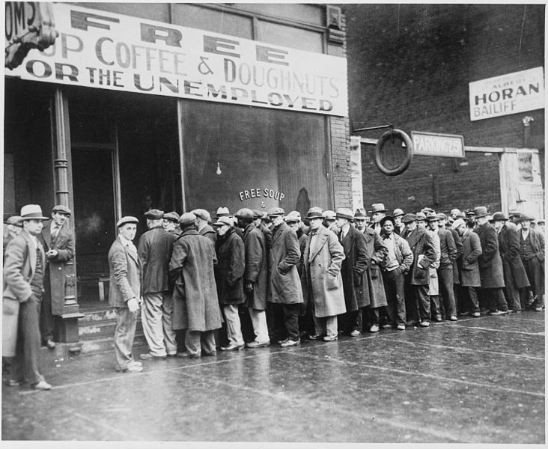
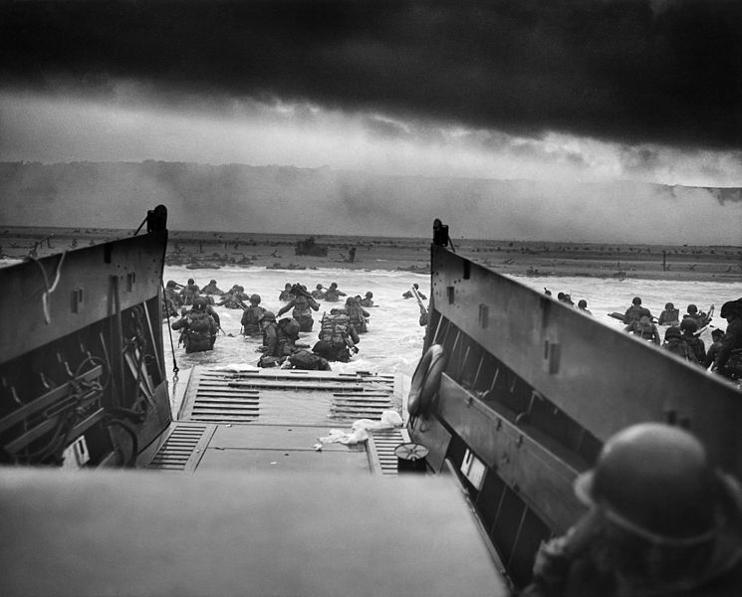
Context
Great Depression
New Deal
Events in Europe
Buildup and Involvement
Source: National Archives and Records Administration, 541927
Second World War
Source: National Archives and Records Administration, 195515
Notes:
Great Depression and economic environment
Dollar had been devalued significantly over the course of the depression, due in large part to the stock market crash
Unemployment reached unprecedented highs*
Estimates vary around 20%, though there are no firm statistics on this as the Bureau of Labor Statistics only began keeping data in 1941, coincidently here for purposes of tracking U.S wartime production
New Deal’s influence
Existence of government work programs
Extreme economic measures undertaken to right the economy including an extremely progressive taxation system
Events in Europe
New American role in global politics
The beginning of the 1900s marked the point when America could no longer participate in international affairs at its leisure; instead, the country became a fixture in the global arrangement of power
Nature of American World War I experience
While the American WWI experience was short, it characterizes previous American international engagement. Economically engaged while committing minimal use of troops abroad.
A ‘League of Nations’ beginning
When the League came about, it was immediately neutered due to U.S. domestic desire to return to a sense of isolationism
Changing attitude toward internationalism
Buildup to wartime
Prior to war engagement, ~400,000 troops. At the height in 1945, ~12,000,000
Nature of WWII involvement
Beginning mirrors World War I engagement. Pearl Harbor changed this.

Slide 5
Wartime Financing and Production
Debt vs. Taxes
Government Spending
Industrial Conversion, Mobilization, and Reconversion
Notes:
Three points will be examined to discuss the economic embattlement of the United States during World War II:
The balance of government financing through Debt vs. Taxes
Government Spending, and more importantly, the drastic rate of change to ready for war
And the unprecedented Industrial Conversion, Mobilization, and Reconversion by the U.S. government of its domestic industries

Slide 6
"Brass" Tax…and Debt
Pre-context of taxation
Structure equaled about 60% to 40%
(Brief) History of debt in America
How debt was raised and intention to repay
Debt as % of GDP
Source: Congressional Budget Office, Department of the Treasury, U.S. Bureau of the Census, and the Board of Governors of the Federal Reserve System
Notes:
Pre-context of taxation
As mentioned before, a heavy taxation regime was implemented during the Great Depression to pay for government unemployment and social welfare programs.
Some estimates have the top income tax bracket for earners over $500,000 at around 75% percent
The balance of the government’s financing equaled about 60% debt to 40% taxes. Thus, even with stringent tax policies, the government needed to put itself into debt to raise over half of the requisite funds.
To do this, the government issued debt in the forms of treasury bills, which are known by many names, including War bonds, U.S. Treasury and Security Bills, “Freedom and Victory Bonds,” Foreign Financing bonds
Notably, The U.S. had not devised a system by which the government would make good on its debts, leaving much of the financing scheme to be figured out after the fighting was over.

Slide 7

Government Spending
Size of the U.S. budget
Expansion of GDP
Government spending for military as a percent of GDP
=
Notes:
Size of the U.S. budget
Some estimates place the increase in the U.S. government’s budget anywhere between four- to six-fold
Expansion of GDP
According to the U.S. Department of Commerce’s Bureau of Economic Analysis, the GDP of the U.S. nearly tripled between 1937 and 1945, from 80 to 223 billion dollars. Over the previous time period, the GDP dipped as low as 50 billion and had been hovering around 90.
Government spending for military as a percent of GDP
At the height of the war, the government was spending as much as fifty percent of the country’s GDP on military products and services. The 1944 GDP equaled 219 billion dollars. Of that, 94.5 billion was government consumption for national defense. That’s 43%. Compare that to the paltry billion and a half the government was spending for the same line item in 1939, just over one percent of the GDP.

Slide 8

Industrial Conversion
Wartime industries prior to WWII
Percent of U.S. economy devoted to wartime production
Ability to rapidly turn over the U.S. economy
Went back to “normal” following the war
Notes:
Donald M. Nelson, head of the War Productions Board whose logo you see there, managed the WPB and oversaw the transition of the economy during the height of the war, inheriting this daunting task from the failing Office of Production Management. He recounts that of the approximately 188,000 industries in the United States, some 45,000 of the largest were targeted for industrial conversion.
While the record is inconclusive regarding the sheer number of companies, the drastic increase in U.S. GDP in the four year period between 1941 and 1945 indicates that the U.S. successfully mobilized its industrial sector for wartime production.
For instance, Ford’s Willow Run plant in Ypsilanti, Michigan was producing one B24 Liberator bomber nearly every hour. The production of the Higgins boat transformed the city of New Orleans, as the company expanded from 75 to 20,000 workers between 1937 and 1943.
Ability to rapidly turn over the U.S. economy
Went back to “normal” following the war

Slide 9

Fallout and Moving Forward
Economic conditions following the conflict
WPB prepares for economic retraction
Tehran, Yalta, and Potsdam determinations
Notes:
Economic conditions following the conflict
Despite only accounting for its debts in that the government planned to draw down the budget deficits, the economic rebuilding programs in Europe and Asia such as the Marshall Plan allowed the U.S. government to transition its, by now, massive economy to civilian production
Additionally, the drawdown plan was meant to be executed over a ten-year period, as Nelson describes in his memoirs. The U.S. did not have this ability as they would engage militarily by Truman’s second term of office events my colleague Nils will describe shortly
WPB prepares for economic and industrial retraction
This transfer of efforts was led by the War Productions Board
Permanent wartime economy not so following the Second World War
Tax versus debt financing will become evident throughout the study
Tehran, Yalta, and Potsdam determinations
New global security and economic paradigm
Stage set for international Cold War between superpowers
No opportunity for U.S. cantonment

Slide 10
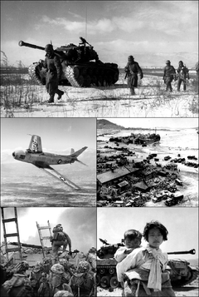
The Korean War
Emergence of the Military-Industrial Complex
Notes:
Stress long term implications.
Source: http://upload.wikimedia.org/wikipedia/commons/thumb/c/ca/Korean_War_Montage_2.png/240px-Korean_War_Montage_2.png

Slide 11
Preface
“Korea was the wrong war, in the wrong place,
at the wrong time.”
J.C. Wylie (1967) Military Strategy: A General Theory of Power Control. p. 66
1950 invasion by North Korea
Three years of war with 1.2 million battle related deaths
Permanent division of Korea on the 38th parallel
Notes:
Battle deaths source: Lacina, Bethany, and Nils Petter Gleditsch. "Monitoring Trends in Global Combat: A New Dataset of Battle Deaths." European Journal of Population
According to DoD: - 34k U.S. battle deaths, 8k missing in action, South Korea 374k civilian, 138k military deaths, PVA 400k, KPA 200k
Divison: 38th parallel

Slide 12
Cold War Context
Paradigm shift in public opinion about communism
Renunciation of Truman’s “minimalist defense budget”
Global network of security alliances
General military modernization
Eisenhower’s “New Look”

Slide 13
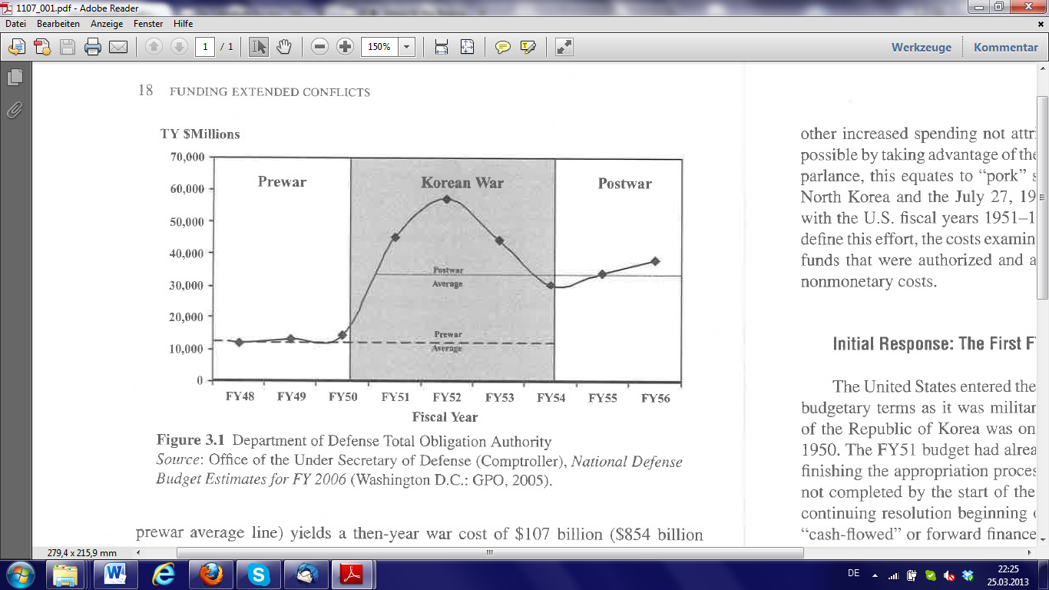
Military Spending
Source: Miller (2007) Funding Extended Conflicts: Korea, Vietnam, and the War on Terror. 2007, p. 18.

Slide 14
U.S. Fiscal Policy During the War
Almost no debt
Increase of labor taxes: 16.2% ➔ 19.8%
Increase of capital taxes: 51.1% ➔ 62.6%
Inflation rate: 0.4%
Total cost: Between $678 billion and $1,001 billion
Notes:
Cost 1 includes: direct cost, mixed, indirect but related
Cost 2: Cost1+ excess manpower, debt service, veteran payments
Labor 22%
Capital 23%

Slide 15
Emergence of the Military-Industrial Complex
Increase of U.S. “readiness”
Higher maintenance cost
Increasing profits in defense industry attract private companies
Regional relocation of defense industry

Slide 16
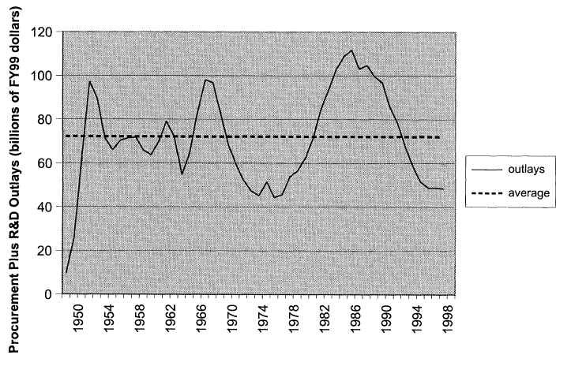
Defense Budget Outlays to the Defense Industry
Source: Gholz & Sapolsky (2000 ) Restructuring the U.S. Defense Industry., p. 8.

Slide 17

Conclusion
Long term implications:
Paradigm shift in U.S. society
Permanent increase in military spending
Emergence of the military-industrial sector
Notes:
Source: http://www.prwatch.org/files/images/militaryspending.jpg

Slide 18
The Vietnam War
Fighting at home and abroad

Slide 19
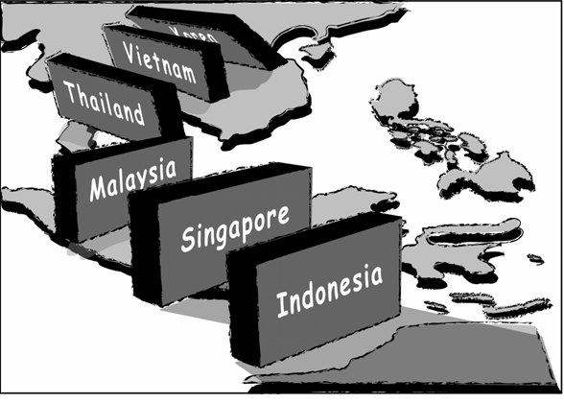
Historical context
Cold War and Anti-Communism
Determination of the timeframe
Waging a war to a full-on war
War against poverty
Notes:
Picture: http://web3.katoomba-h.schools.nsw.edu.au/hsie/images/stories/yr10hist/domino.png

Slide 20
The Two Front War
The Vietnam War and the War Against Poverty
Why the Vietnam War was different
The significance of the wars and their impact
  Full employment
  Aggregate demand
  Inflation

Slide 21
The Economics
Great Society and its effects
  War-tax became surcharge in 1968
  Increasing government spending
Tax Reform Act of 1969
  Recession in 1970

Slide 22
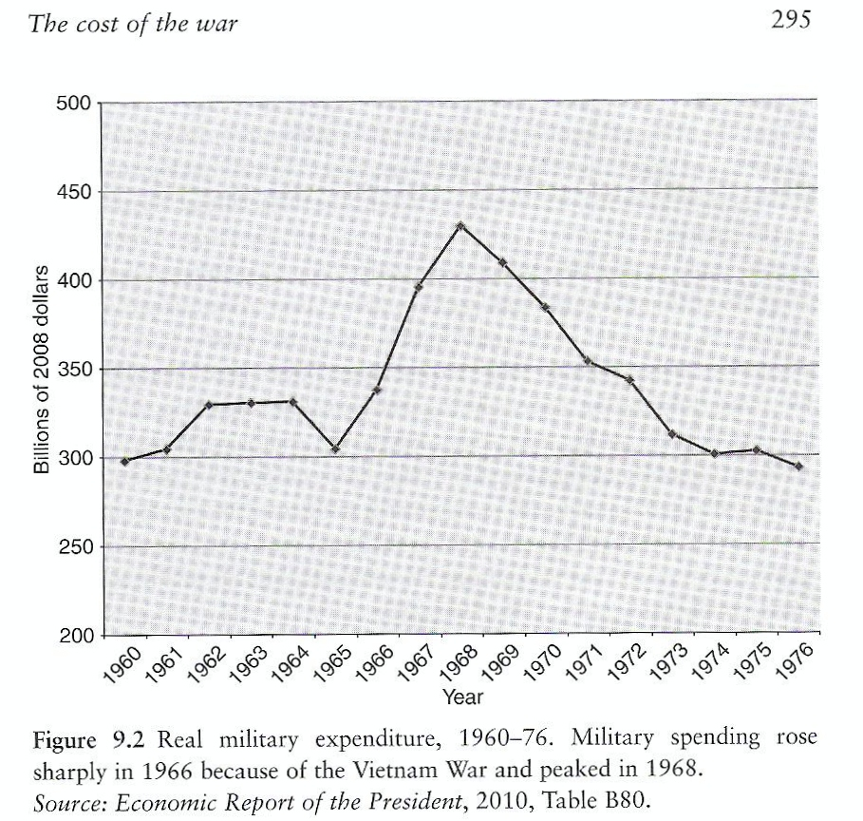
The Economics
Notes:
Source: Rockhoff, Hugh. America's Economic Way of War. 1st ed. Cambridge, UK: Cambridge University Press, 2012. 295.

Slide 23
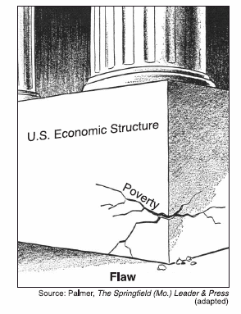
Conclusion
The two front war
Economic growth
Increased tax rates
Notes:
Source: http://teacherpages.nhcs.net/schools/Ashley/beverlyclinch/Documents/goals%2010,11,12/gs.gif

Slide 24
Operation Desert Shield/Storm
Entrance into the Gulf

Slide 25
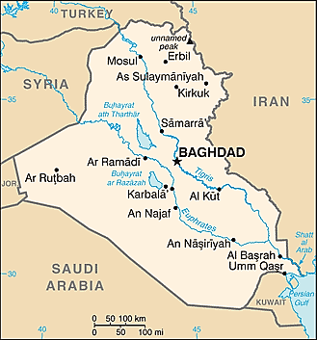
Geographical Illustration
Showing the geographical locale of Kuwait in relation to Saudi Arabia and Iraq.
“Middle East: Iraq,” CIA World Fact Book (updated March 26, 2013) https://www.cia.gov/library/publications/the-world-factbook/geos/iz.html.

Slide 26
Timeline
Saddam Hussein invades Kuwait on August 2, 1990
The United States commits ground troops on August 7, 1990 (Operation Desert Shield)
The U.S. began the air war campaign on January 17, 1991 (Operation Desert Storm)

Slide 27
Oil and War
With Iraq encroaching on Kuwait months before the August invasion, the oil markets became stressed from uncertainty.
  Pre-invasion price movement:
Days after the Iraq invasion, on August 6, President G.H.W. Bush verbally committed troops to the Gulf (Operation Desert Shield).
  By August 9, oil prices had dropped to $2 less than August 7 prices.
$17
June 1990
$21
July 1990
$28
August 7, 1990

Slide 28
Operation Desert Shield (August 7)
When the U.S. responded to the Gulf crisis with a commitment to sending ground forces, they used a strategy called Naval Forward Engagement.
  Impact on the economy:
Forward engagement allowed for a quick military response to the Gulf crisis thereby averting any further movement by Hussein into Saudi Arabia.
$3.21 Billion
Savings in oil purchases
$55.2 Billion
Savings to the U.S. GDP
$83.6 Billion
Estimated savings of the worldwide impact

Slide 29
Economic Measures
FY 1990 and 1991 experienced a reduction in military expenditures as a percent of GDP:
  FY 1988 – 5.7%
  FY 1989 – 5.6%
  FY 1990 – 5.2%
  FY 1991 – 4.6%
The U.S. still experienced a recessionary period which is attributed to the increase in oil prices.
  1990 inflation – 5.3%
    Dropped to 4.4% in 1991
  1990 unemployment – 5.5%
    Rose to 6.8% in 1991 (jobless recovery)

Slide 30
CONCLUDING THOUGHTS

Slide 31
War on Terror and Its Ramifications

Slide 32
Costs of War
Congressional Research Service
  $1.3 trillion (current)
  $1.8 trillion (estimate)
Costs of War Project
  $3.1 trillion
Joseph Stiglitz and Linda Bilmes
  > $3 trillion
Notes:
“War on Terror”
2001 attacks on World Trade center caused a reactionary war on Iraq and Afghanistan. Auxiliary conflicts such as pakistan, yemen, somalia and a broad international pursuit of radical non-state armed groups result in what the media has dubbed as the war on terror.
The two primary and most costs wars are Iraq and Afghanistan
Challenges to Calculating Costs
Calculating the costs of any conflict can be challenging—difficulty allocating resources; however, the war on terror poses specific challenges in terms of transparency issues—government accounting and emergency appropriations make it difficult to determine what costs were allocated to the war and for what reason. Opportunity costs always require economic assumptions that are at the mercy of the biases of the individual. Because the conflict is ongoing determining future conflicts requires much guess work.
Congressional Research Service
Examines only congressional appropriated funds by congress as well as FY2012 requests to congress. Argues that more than 1.3 trillion has been given to the war 95% is to the DoD. In FY 2021 estimates that $1.8 trillion will be spent on the war
Stiglitz and Costs of War
These two take into account the indirect costs of war. Therefore they are inherently subject to suspicion. However, both attempt to be conservative in order to maintain credibility. Stiglitz argues that post 9/11 conflicts will cost more than 3 trillion. A more specific analysis by the costs of war argues that $3.1 trillion has been spend on post 9/11 wars and that it will reach $3.6 trillion with an additional $1 trillion that may be added for interest costs.
Other sources such as edwards and wheeler?

Slide 33
Reasons for High Costs
Increased reliance on military contractors
  $31-60 billion unaccounted
  Military benefits increased
Indirect costs
  Benefits
  USAID
  United States Security
Interest costs
Notes:
There are a few things that are different within the Iraq and Afghanistan wars. 1. the wars were entirely funded through debt. And two an increased reliance on military contractors. These are explanations for the high costs.
Increased Reliance on Military Contractors
Throughout the Iraq and Afghanistan wars there is an increased reliance on military contractors reaching 260,000 in 2010 spending roughly $206 billion on total post 9/11 wars. The commission on wartime contracting found that 30 to 60 billion was unaccounted for in contractors. This increases the costs of conflict substantially. Also, the military has had to increase benefits and pay in order to compete with the military industry to recruit and retain soldiers.
Indirect Costs
Indirect costs should be allocated as the government must pay them, however it is difficult to know the timeline and extent of such costs. Benefits hard to quantify because the true cost will peak years later. However, estimates say that since FY01 11.4 billion was spent on health benefits.
Interest Costs
Because the conflicts were financed through debt, the U.S. must pay substantially more for each conflict. Estimates on the amount of interest that must be paid range from a low estimate of $260 billion to over $1.5 trillion, which is almost equal to the current budgetary allocations on the wars.

Slide 34
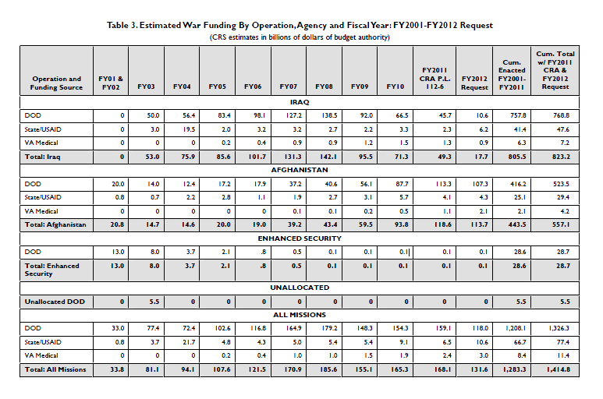
Trends
Notes:
Trends
These trends specifically look at congressional allocations and requests, focusing mostly on the two main conflicts within the war on terror—Iraq and Afghanistan.
Estimations—First it’s important to understand that before 2002, the Iraq war was estimated to only cost 50 billion. Lawrence Lindsey. William Nordhaus suggested that if the conflict becomes protracted, $2 trillion.
Iraq moved from $50 billion in 2003 to almost $131 billion by 2007.
Withdrawal in 2009 decreased costs to $53 billion in FY11. FY 12 est 17.7 billion
Afghanistan had more humble beginnnings with only $15 billion in 2003. This increased to $60 billion in FY09 and $119 billion in FY11. although withdrawal is expected in 2014, 8,000 to 10,000 troops are still expected to stay therefore, it is uncertain what the costs will be post withdrawal.
This graph clearly demonstrates that indirect costs discussed earlier, such as 28.7 billion spent on Enhanced security as well as the State/ USAID allocations of 47.6 and 29.4, respectively.
It’s also interesting to note that, although the 30 to 60 billion lost to contractors may seem small in comparison to large totals, the high range of those estimates are almost equal to the entire budget for the State and USAID departments.

Slide 35
Ramifications
Increased military spending
Increased debt
  Emergency appropriations
  Decrease in taxes
Changes in interest rates
Oil price correlation unclear
Impact of the financial crisis
Notes:
The High costs of the conflict have lead to increased military spending by almost 60% between 2002-2011. Increases in this spending has ramifications on debt and other economic variables.
Increase in Debt
The Wars were finance entirely through emergency appropriations, which were specifically funded through debt and debt alone. Therefore, Public debt has increased throughout the 21st century. Marketable securities make up 95% of public debt. 2/3 in Treasury Bonds. Both foreign and domestic debt have almost doubled. In 2003 a decrease in taxes lead to increased debt. As spending exceeded revenue, the country financed debt in order to maintain the deficit.
Changes in Interest Rates
High levels of debt tend to increase interest rates however these affects are mitigated by the financial crisis. Economists expect interest rates to increase almost 70 points because of increased spending. This is skewed because of spending before the recession and the fiscal policy of the recession.
Oil Correlation is Unclear
It is a high debate, most analysis remain conservative, at only a 7 to 10 dollar increase in the dollar price, in order to maintain the integrity of their analysis.
Financial Crisis
The financial crisis changed the trajectory of the war. The U.S. shifted from a foreign viewpoint based on military operations to a more domestic examination of its own fiscal policy. The financial recession shifted america’s focus

Slide 36
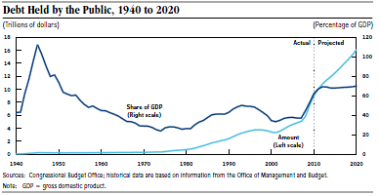
Notes:
This graph gives an overview of the trajectory of debt throughout the war on terror.
In 2001 debt was the lowest it had been since the 1980s, 34% of GDP.
In 2002- 2007 debt increased by 1.7 trillion in response to the Iraq and afghanistan wars. However, increases in gdp only increased debt as a percent of gdp to 37% because the increase in debt was combined with an increase in GDP.
2008 Debt as a % of GDP increased significantly as the government flooded the market with money in order to prevent another great depression.

Slide 37
Conclusion
Economic recession changes the context of the war on terror
Ramifications of the War on Terror still relevant
Notes:
In conclusion…
It changes the context because, although we were spending a lot of money, military expenditures were increasing and total debt was rising, we are currently spending 85 billion dollars a month in order to mitigate the effects of the recession.
However, the ramifications of the War on Terror alone are still relevant, even if they pale in comparison to the spending the happens to save the country from the recession, because they denote a tendency within government spending to simply borrow money to finance war. That isn’t a sustainable option, especially with increasing debt from an economic recession.
“The sharp rise in debt stems partly from lower tax revenues and higher federal spending related to the recent sever recession and turmoil in financial markets. However, the growing debt also reflects an imbalance between spending and revenues that predated those economic developments.
read quote…

Slide 38
Military Spending and the U.S. Economy
Policy Implications for the Future

Slide 39
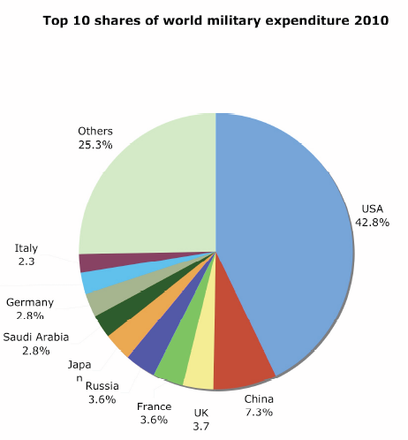
Source: http://thinkprogress.org/politics/2011/04/11/157596/military-spending-doubled-since-2001/?mobile=nc
Notes:
As it stands, we spend more than the next twenty countries combined, and for what? For what are we trading off, for what are we sacrificing, and what are we receiving for our added expenses?
Source http://thinkprogress.org/politics/2011/04/11/157596/military-spending-doubled-since-2001/?mobile=nc

Slide 40
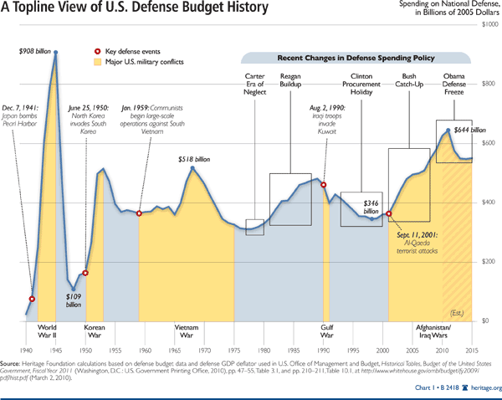
Notes:
Likewise, spending for military purposes has been gradually building since the 1948 dip following the Second World War. But this graph represents solely the defense budget of the United States. What if we included, as my colleagues have mentioned, the added cost of veterans care ten, twenty, thirty years after the fact.

Slide 41
Lessons from History
Military spending is parasitic growth, or at least unsustainable in the long run
Proportional to GDP spending too much during peace time
Wartime ‘peaks’ followed by retraction best model
Who pays and how? Someone has got to foot the bill
Notes:
Military spending is parasitic growth, or at least unsustainable in the long run: Seymour Melman likened military spending to parasitic economic growth in that production for military purposes rarely is manifested in the common consumption market. Basically, most people don’t buy the products put out. Military equipment is not used as start-up capital for small businesses, it is not returned to the industrial sector for reinvestment, and it has little to no resale value for our economy.
Proportional to GDP spending too much during peace time
Someone has got to foot the bill: Permanent militarization and engagement in wars possible because costs are being deferred to later generations through debt. The wars paid for by taxes, while directly financed, were immensely unpopular because of the personal grievance felt by citizens.

Slide 42
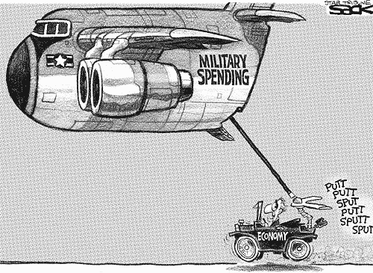
Military Spending and the U.S. Economy
Source: http://4.bp.blogspot.com/-J6X6pUa1wCc/TaSUZOnDRII/AAAAAAAADL4/nREZjd1M4eE/s1600/military-spending.gif
Notes:
We have now reached the point where military spending, specifically in government outlays to defense contractors, has become integral and almost irreplaceable to the vitality of the U.S. economy

Slide 43
Policy Implications
Costs should be “internalized” to current household
Link military expenditure to tax increases
Balance the budget
Increase awareness of implications of military endeavors
Realistic cost assessments
Notes:
Comparison: military expenditure and smoking, consequences are not felt immediately

Slide 44
References
Campagna, Anthony S. The economic consequences of the Vietnam War. 1st ed. New York, USA: Praeger Publishers, 1991.
Daggett, Stephen. “Costs of Major U.S. Wars.” Congressional Research Service Report for Congress. June 2010.
Defense Budget Outlays to the Defense Industry: Gholz & Sapolsky (2000 ) Restructuring the U.S. Defense Industry., p. 8.
Flournoy, Michele and Janine Davidson. “Obama’s New Global Posture: The Logic of U.S. Foreign Deployment.” Foreign Affairs. Vol. 91, no. 4. July/August 2012. 54-63.
Labonte, Marc and Mindy Levit. Financing Issues and Economic Effects of American Wars. Congressional Research Service, Report for Congress, July 29, 2008.
Level of Debt in the United States, 1790-2000: Congressional Budget Office, Department of the Treasury, U.S. Bureau of the Census, and the Board of Governors of the Federal Reserve System
Looney, Robert and David Schardy and Ronald Brown. “Estimating the Economic Benefits of Forward-Engaged Naval Forces.” Interfaces. Vol. 31, no. 4. July – August 2001. 74-86.
“Middle East: Iraq.” CIA World Fact Book (updated March 26, 2013). https://www.cia.gov/library/publications/the-world-factbook/geos/iz.html.
Park, Chang Jin, American Foreign Policy in Korea and Vietnam: Comparative Case Studies, The Review of Politics, Vol. 37, No. 1, 1975,

Slide 45
References
Stevens, Robert Warren. Vain hopes, grim realities. 1sr ed. New York, USA: New Viewpoints, 1976.
The Costs of War in Vietnam: Rockhoff, Hugh. America's Economic Way of War. 1st ed. Cambridge, UK: Cambridge University Press, 2012. 295.
“The Operation Desert Shield/Desert Storm Timeline.” News: American Forces Press Service. U.S. Department of Defense. August 8, 2000. http://www.defense.gov/news/newsarticle.aspx?id=45404.
Top 10 Shares of World Military Expenditure, 2010: http://thinkprogress.org/politics/2011/04/11/157596/military-spending-doubled-since-2001/?mobile=nc
Stiglitz, Joseph and Linda Bilmes. “Estimating the Costs of War: Methodological Issues, with Applications to Iraq and Afghanistan” in The Oxford Handbook of the Economics of Peace and Conflict. Edited by Michelle R Garfinkel and Stergios Skaperdas Oxford: Oxford Handbooks, 2012.
Stiglitz, Joseph and Linda Bilmes. The Three Trillion Dollar War. New York:W.W. Norton & Company, 2008.

Slide 46
U.S. Joint Economic Committee. War at Any Cost? The Total Economic Costs of the War Beyond the Federal Budget Hearing, 28 February 2008. Government Printing Office, 2009. (42-775 PDF:1-280).
U.S. Library of Congress, Congressional Research Service The Cost of Iraq, Afghanistan and Other Global War on Terror Operations Since 9/11 by Amy Belasco. CRS Report RL33110. Washington DC: Office of Congressional Information and Publishing, 2011.
Crawford, Neta. “U.S. Costs of Wars Throughout 2013: $1.3 Trillion and Counting: Summary of Costs for the U.S. Wars in Iraq, Afghanistan and Pakistan
Edwards, Ryan. “Post-9/11 War Spending, Debt, and the Macroeconomy.” Paper presented at the meeting of the project on Burdens of War: The Consequences of the U.S. Military Response to 9/11, Brown University, January 4, 2011.
Congressional Budget Office (CBO). “Federal Debit and Interest Costs.” Data from Department of the Treasury, the Board of Governors of the Federal Reserve System and the Congressional Budget Office. December 2010.

Slide 47
Congressional Budget Office (CBO) “Testimony: The Budget and Economic Outlook: Fiscal Years 2013 to 2023.” Data from Department of the Treasury, the Board of Governors of the Federal Reserve System and the Congressional Budget Office. February 2013.
“Transforming Wartime Contracting: Controlling costs, reducing risks” Commission on Wartime Contracting in Iraq and Afghanistan,Final Report to Congress, August 2011.

Slide 48
Thank You

Slide 49
Q&A

